Slide 1
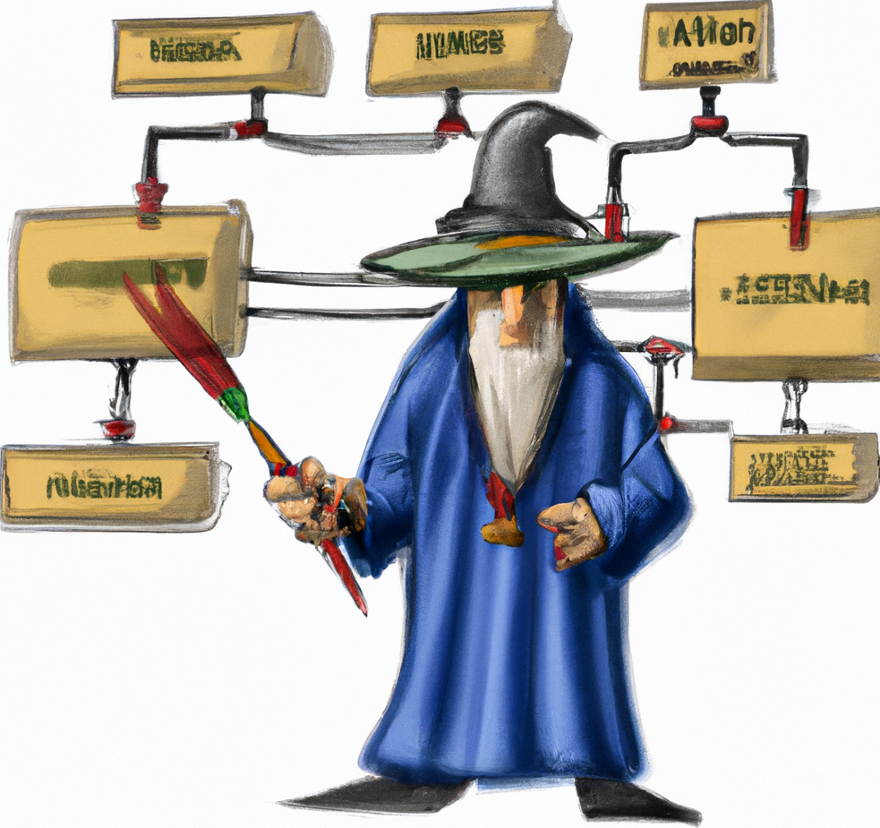
The Protocol Master
Impossible Testing at hand

Slide 2

Main features
Chaos Engineering: Simulate errors, rate limiting, responses
Fast Mock: Mock entire infrastructures in minutes
Simulate: Simulate non existing APIs
Protocols covered:
HTTP, HTTPS, Soap, REST,
MySQL, Postgres, Mongo Db, Redis RESP2, Redis RESP3
AMQP 0.9, MQTT 3, MQTT 5

Slide 3
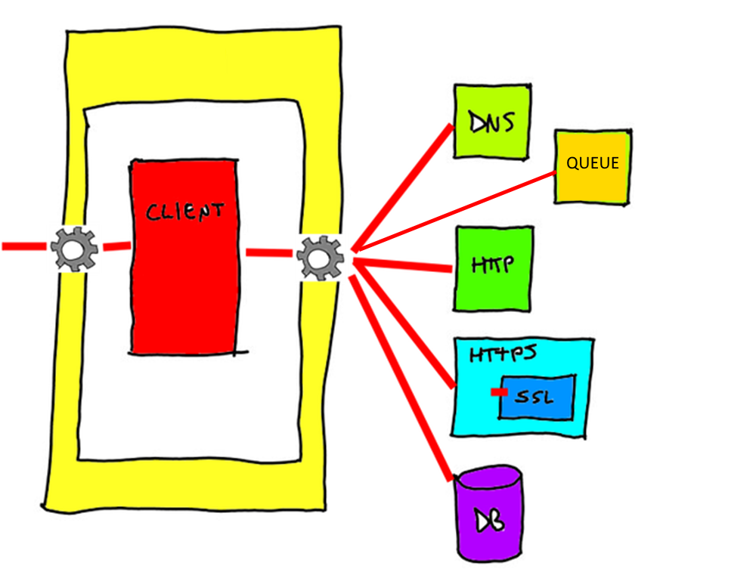
What it is
A proxy
An emulator
A mock
A gateway

Slide 4
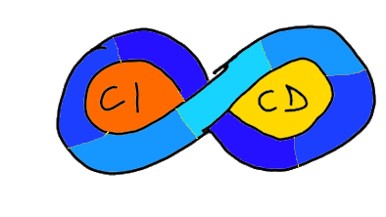











Environment
Run in
Local Proxy
Docker image
MITM
CI/CD Integration
Agnostic in respect of
Language
Infrastructure
Architecture

Slide 5
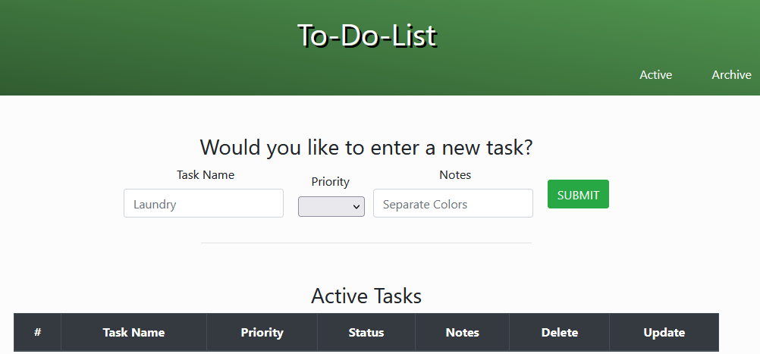
.net Core To-Do App – Chaos engineering
Tech stack:
.net Core
Entity Framework
MySQL
Steps
Setup locally
Rate limits
Errors
Notes:
Run TPM from command line
Run the .NET application locally in debug
Access the application via TPM proxy
Open at least 5 java rest
Introduce random errors
Introduce rate limits (refresh wildly)
http://localhost:8081/swagger-ui/index.html
http://java-rest/

Slide 6
.net Core To-Do App – Simulation
Tech stack:
.net Core
Entity Framework
MySQL
Steps
Setup on Docker
Record
Replay DB
Replay API
Notes:
This is the full infrastructure recording
Explore the data recorded: http://localhost:8081/api/global/storage/items?maxLength=100
Explore a response item: http://localhost:8081/api/global/storage/items/mqtt-01/0000000009

Slide 7
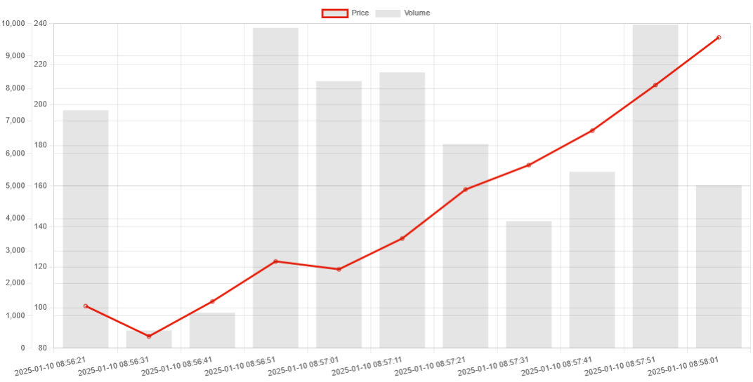
Java Stock Quotes App – Queue Simulation
Tech stack:
Spring Boot
MQTT
MySQL
Steps
Setup
Record
Replay Broker
Send message manually
Notes:
This is the full infrastructure recording
Explore the data recorded: http://localhost:8081/api/global/storage/items?maxLength=100
Explore a response item: http://localhost:8081/api/global/storage/items/mqtt-01/0000000009
Try Without quote generator
Try Without mosquitto
{
"contentType": "application/json",
"body": "{\"symbol\":\"META\",\"date\":1737495412037,\"price\":400,\"volume\":4000}",
"topic": "quotations"
}

Slide 8
Other features
Plugin based
Event based architecture
Mock specific requests
Rewrite request responses
Expose custom API (with Swagger)
Run via command line
SSL MITM approach
All is JSON

Slide 9
Random Tech stuffs
Custom DI Engine
Custom Web Routing engine
Pf4j-based plugins
Behavior Tree/FSM byte level protocol parsing
78% test coverage
Transform SQL queries
Reimplemented default Java http server to reload SSL certificates dynamically
Easily extensible with other protocol

Slide 10



Next steps
A decent UI
Kafka
Amqp 1.0
SQL Server

Slide 11
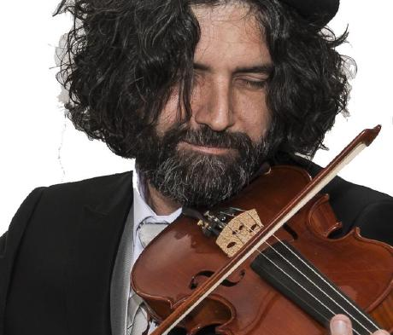
Finally
http://www.github.com/kendarorg
https://www.linkedin.com/in/enricodaros/
enrico.daros@gmail.com
https://www.kendar.org

